Slide 1
Incorporating non-random mixing into models
Jeehyun Lee
Mathematics / Computational Science & Engineering
Yonsei University

Slide 2
Quiz: Heterogeneous mixing patterns
Suppose the same proportion of children are vaccinated against a
new strain of influenza in both populations, no adults vaccinated.
Q: In which population will the vaccine have a stronger effect?
Y
O
Y
O
Population A
Population B

Slide 3
Quiz: Heterogeneous mixing patterns
Answer: childhood vaccination most effective in population B
(Think about what the net reproduction number would be if all
children were to be vaccinated with a vaccine with 100% efficacy.)
Y
O
Y
O
Population A: R_{n}=2
Population B: R_{n}=1

Slide 4
Topics
Introduction to heterogeneous transmission models
Methods for incorporating heterogeneous mixing into models
Assumptions on the structure of WAIFW
Use of survey data on contact patterns
Impact of heterogeneous mixing patterns on the transmission dynamics and control of infectious diseases

Slide 5
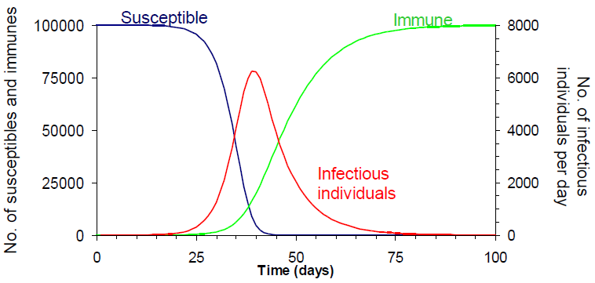








Homogeneous transmission model
𝜆(𝑡) force of infection = $βI(t)$
𝛽 transmission rate
$1/f$ pre-infectious period
$1/r$ duration of infectiousness
$$λ(t)$$
$$f$$
$$r$$
$$S(t)$$
$$E(t)$$
$$I(t)$$
$$R(t)$$

Slide 6
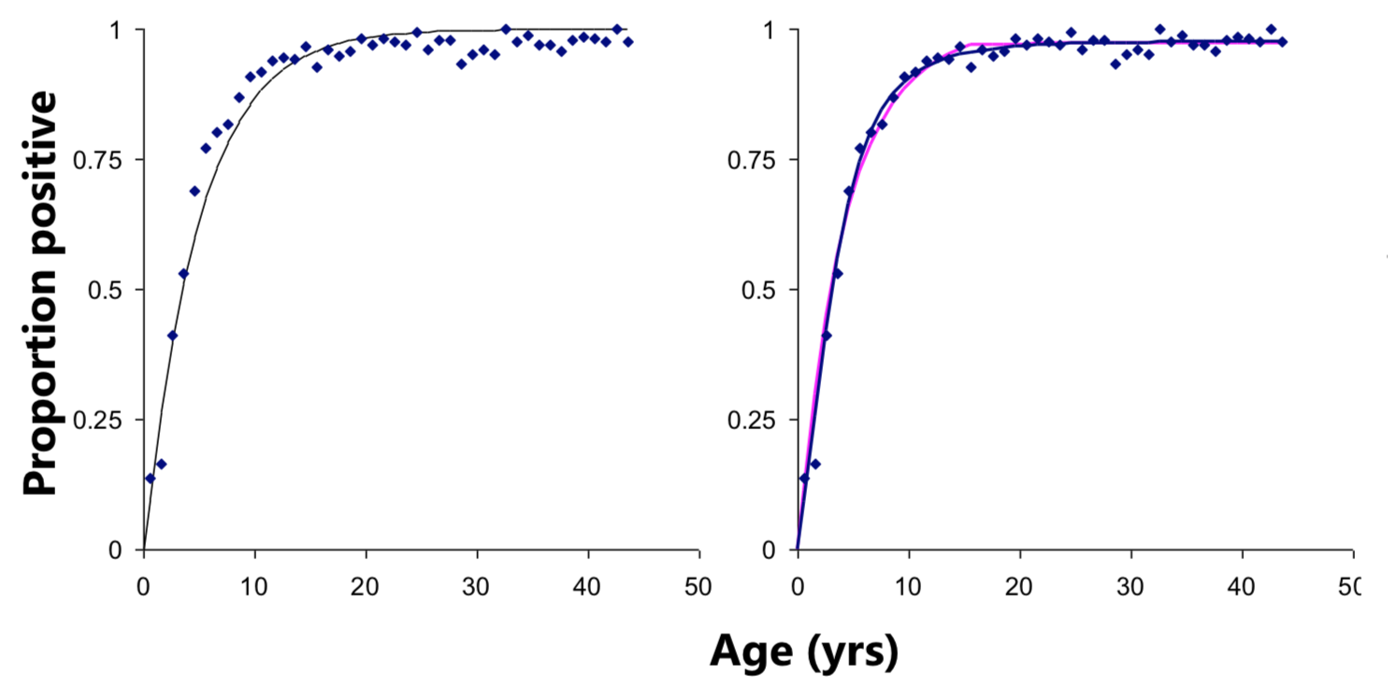
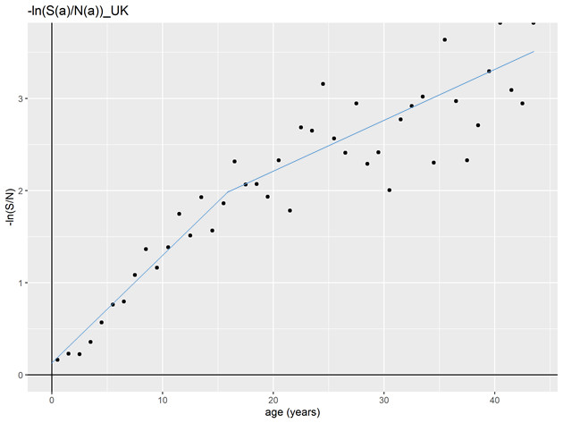
Model fits data of rubella (UK)
Simple catalytic model
Age-dependent catalytic model
Comparison between model fits to seroprevalence data of rubella in the UK (1980s) [Farrington, Stat Med 1990]

Slide 7
Reasons for heterogeneous FOI
Age-dependent mixing patterns
Children are most likely to mix with other children, who are also most likely to be infectious, at least for measles, rubella etc.
Age-dependent differences in susceptibility
Children may more likely to be susceptible to infection than adults.
Genetic differences in susceptibility or exposure
High or low risk groups / Different area

Slide 8
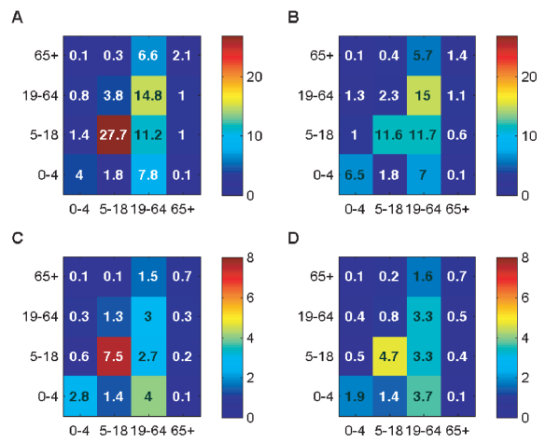
Age-dependent contact patterns
Evidence for an age-dependency in contact patterns [Eames et al. PLoS Comp Bio 2012]
A: conversational contacts during school term time; B: conversational contacts during school holidays;
C: physical contacts during school term time; D: physical contacts during school holidays

Slide 9

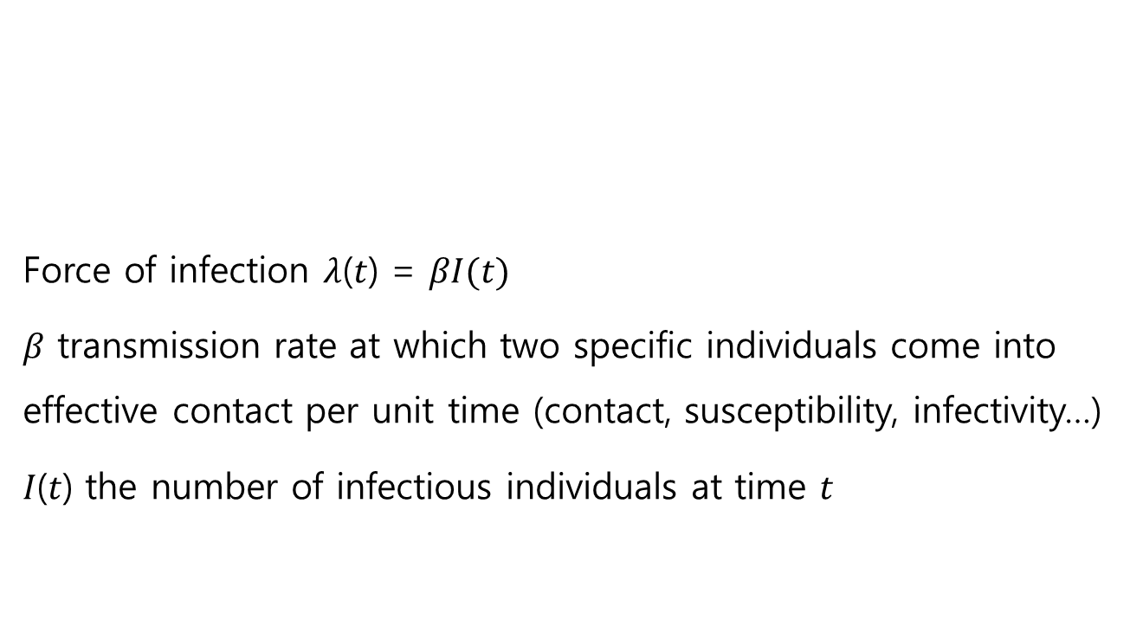


FOI for homogeneous mixing
Force of infection 𝜆(𝑡) = $βI(t)$
𝛽 transmission rate at which two specific individuals come into effective contact per unit time (contact, susceptibility, infectivity…)
𝐼(𝑡) the number of infectious individuals at time $t$
$$λ(t)$$
$$S(t)$$
$$E(t)$$

Slide 10
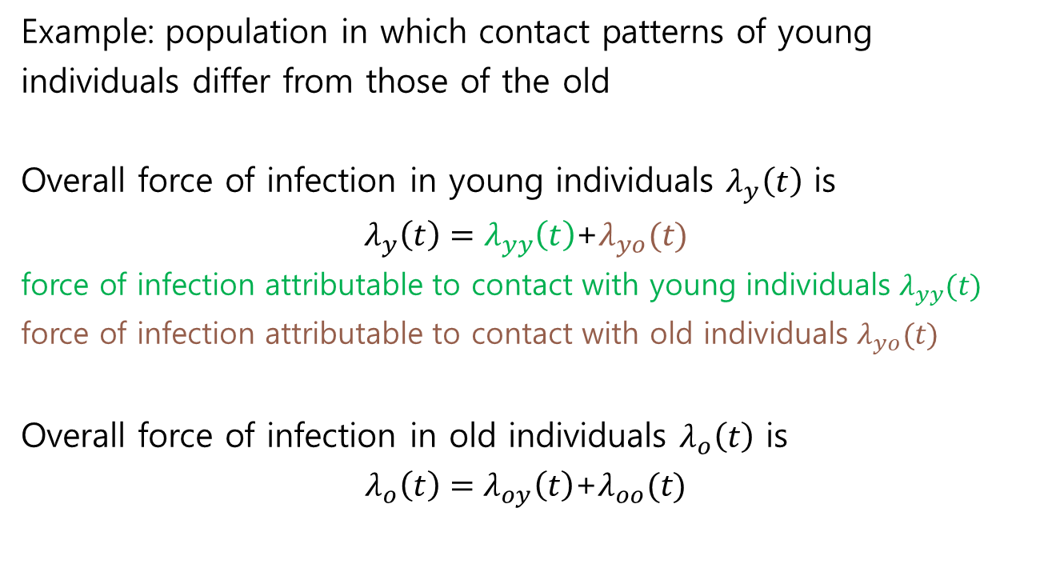
FOI for heterogeneous mixing
Example: population in which contact patterns of young
individuals differ from those of the old
Overall force of infection in young individuals $λ_{y}\left(t\right)$ is
$λ_{y}\left(t\right)=λ_{yy}\left(t\right)$+$λ_{yo}(t)$
force of infection attributable to contact with young individuals $λ_{yy}(t)$
force of infection attributable to contact with old individuals $λ_{yo}(t)$
Overall force of infection in old individuals $λ_{o}\left(t\right)$ is
$λ_{o}\left(t\right)=λ_{oy}\left(t\right)$+$λ_{oo}(t)$

Slide 11
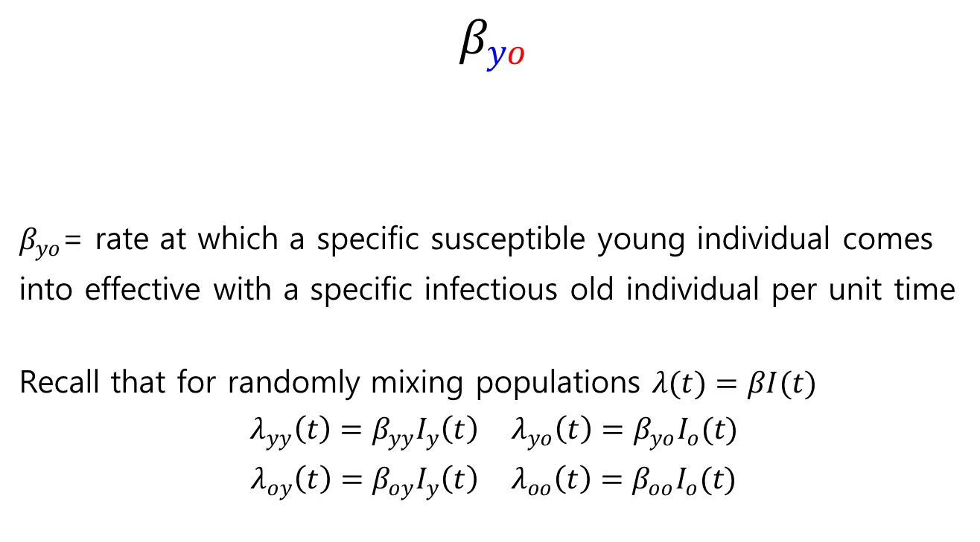
FOI for heterogeneous mixing
$$β_{yo}$$
$β_{yo}$= rate at which a specific susceptible young individual comes
into effective with a specific infectious old individual per unit time
Recall that for randomly mixing populations $λ(t)=βI(t)$
$λ_{yy}\left(t\right)=β_{yy}I_{y}\left(t\right)$ $λ_{yo}\left(t\right)=β_{yo}I_{o}(t)$
$λ_{oy}\left(t\right)=β_{oy}I_{y}\left(t\right)$ $λ_{oo}\left(t\right)=β_{oo}I_{o}(t)$
category of the susceptible person
category of the infectious person

Slide 12

WAIFW matrix
Force of infection
$λ_{y}\left(t\right)=λ_{yy}\left(t\right)\text{+}λ_{yo}(t)=β_{yy}I_{y}\left(t\right)$+$β_{yo}I_{o}(t)$
$λ_{o}\left(t\right)=λ_{oy}\left(t\right)\text{+}λ_{oo}(t)=β_{oy}I_{y}\left(t\right)$+$β_{oo}I_{o}(t)$
Matrix equation
$$\left[\begin{matrix}λ_{y}\left(t\right) \\ λ_{o}\left(t\right)\end{matrix}\right]=\left[\begin{matrix}β_{yy} & β_{yo} \\ β_{oy} & β_{oo}\end{matrix}\right]\left[\begin{matrix}I_{y}\left(t\right) \\ I_{o}\left(t\right)\end{matrix}\right]$$
WAIFW (Who Acquires Infection From Whom) matrix

Slide 13
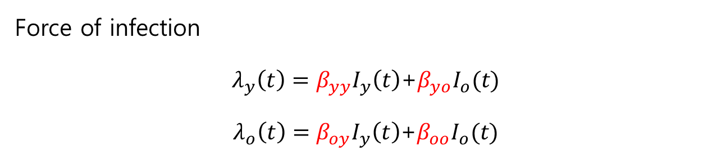
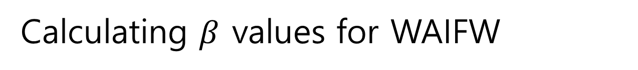
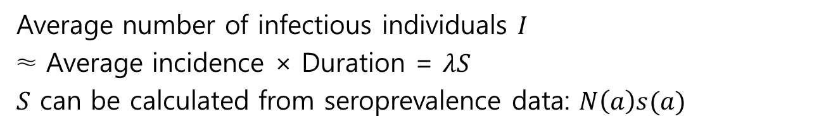
Calculating $β$ values for WAIFW
Force of infection
$λ_{y}\left(t\right)=β_{yy}I_{y}\left(t\right)$+$β_{yo}I_{o}(t)$
$λ_{o}\left(t\right)=β_{oy}I_{y}\left(t\right)$+$β_{oo}I_{o}(t)$
Average number of infectious individuals $I$
≈ Average incidence × Duration = $λS$
𝑆 can be calculated from seroprevalence data: $N\left(a\right)s(a)$
We have 2 equations with 4 unknowns
→ need to reduce the equations to 2 equations in 2 unknowns

Slide 14





Structures for WAIFW matrix
If we can measure effective contacts (semi-) directly, then use this to complete the matrix of $β$values.
If not, we usually have to impose constraints by making assumptions about the structure of the WAIFW matrix.
$$\left[\begin{matrix}β_{yy} & β_{yo} \\ β_{oy} & β_{oo}\end{matrix}\right]$$
$$\left[\begin{matrix}β_{1} & 0 \\ 0 & β_{2}\end{matrix}\right]$$
$$\left[\begin{matrix}β_{1} & β_{2} \\ β_{2} & β_{2}\end{matrix}\right]$$
$$\left[\begin{matrix}β_{1} & β_{2} \\ β_{2} & β_{1}\end{matrix}\right]$$
Examples

Slide 15
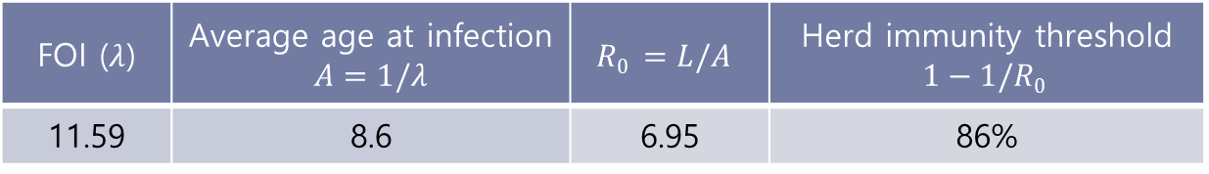
Rubella model for vaccination policy
The proportion seropositive to rubella antibodies in the UK during the 1980s.
[Farrington, Stat Med 1990]
FOI ($λ$) | Average age at infection $$A=1/λ$$ | $$R0 =L/A$$ | Herd immunity threshold $$1−1/R0$$
11.59 | 8.6 | 6.95 | 86%

Slide 16
Rubella: Heterogeneous model

Slide 17
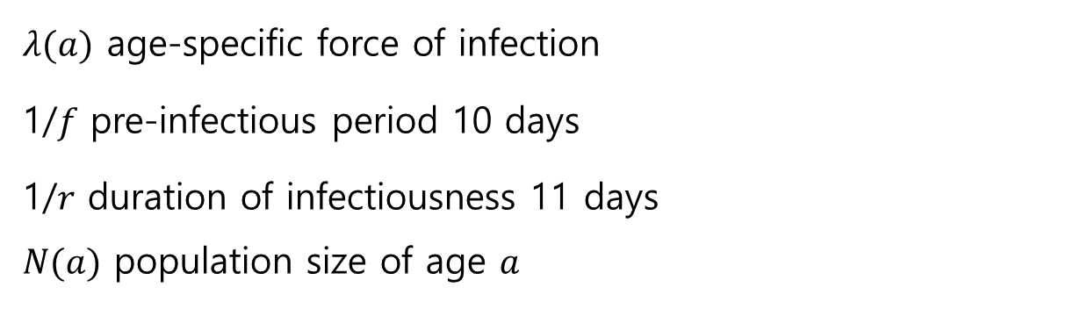
Rubella: Ingredients to calculate WAIFW
$λ(a)$ age-specific force of infection
1/𝑓 pre-infectious period 10 days
1/𝑟 duration of infectiousness 11 days
$N(a)$ population size of age $a$
Age group | Average annual FOI | Average daily FOI | Number susceptible | Number infectious
Young | 0.1329 | 0.000364 | 5012 | 20.1
Middle-aged | 0.0417 | 0.000114 | 3083 | 3.9
Old | 0.0417 | 0.000114 | 2739 | 3.4

Slide 18

Rubella: Structures for WAIFW
$$\left[\begin{matrix}β_{11} & β_{12} & β_{13} \\ β_{21} & β_{22} & β_{23} \\ β_{31} & β_{32} & β_{33}\end{matrix} \right]\left[\begin{matrix}I_{y} \\ I_{m} \\ I_{o}\end{matrix}\right]=\left[\begin{matrix}λ_{y} \\ λ_{m} \\ λ_{o}\end{matrix}\right]$$
$\left[ \begin{matrix}β_{1} & 0 & 0 \\ 0 & β_{2} & 0 \\ 0 & 0 & β_{3}\end{matrix} \right]$ $\left[ \begin{matrix}β_{1} & β_{2} & β_{3} \\ β_{2} & β_{2} & β_{3} \\ β_{3} & β_{3} & β_{3}\end{matrix} \right]$

Slide 19
Rubella: Dynamics without vaccination
 | Average % susceptible |  |  | Average daily number of new infections/100,000
Age group | Young | Middle-aged | Old | Young | Middle-aged | Old
Original | 33.41 | 20.56 | 9.13 | 12.16 | 2.35 | 1.04
WAIFW A | 33.61 | 20.44 | 9.01 | 12.13 | 2.41 | 1.04
WAIFW B | 33.53 | 20.66 | 9.20 | 12.14 | 2.35 | 1.05

Slide 20
Rubella: Impact of vaccination
Proportion susceptible | Daily number of new infections /100,000 | Critical level of coverage 1-1/R₀
 |  | 1-1/10.9 = 90.8%
 |  | 1-1/3.6 = 72.2%

Slide 21
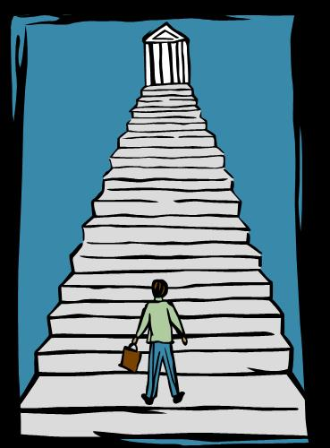

Rubella: Take home message
The impact of control will depend on the extent of mixing between individuals in your population
An important problem is that you can never be sure of which WAIFW matrix best describes mixing patterns in your population – you can find several WAIFW matrices which fit the observed data but predict a different impact
To use this kind of model to guide policy, you would need to explore the implications of several different mixing patterns and (probably) base your recommendation on the most pessimistic scenario

Slide 22
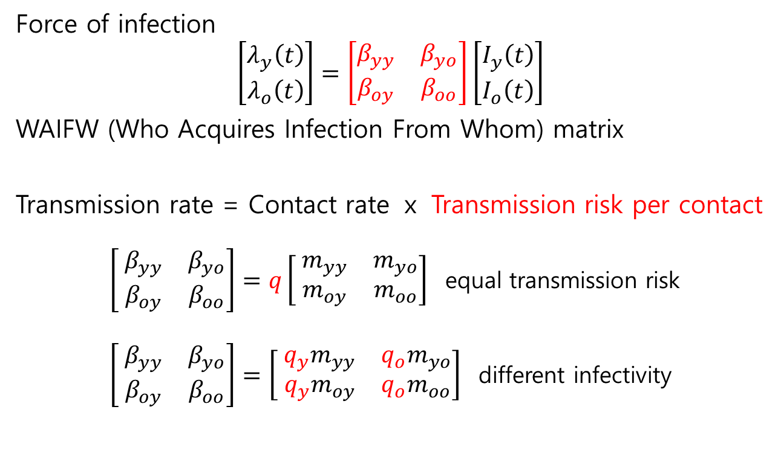
Measure of contacts
Force of infection
$$\left[\begin{matrix}λ_{y}\left(t\right) \\ λ_{o}\left(t\right)\end{matrix}\right]=\left[\begin{matrix}β_{yy} & β_{yo} \\ β_{oy} & β_{oo}\end{matrix}\right]\left[\begin{matrix}I_{y}\left(t\right) \\ I_{o}\left(t\right)\end{matrix}\right]$$
WAIFW (Who Acquires Infection From Whom) matrix
Transmission rate = Contact rate ⅹ Transmission risk per contact
$\left[ \begin{matrix}β_{yy} & β_{yo} \\ β_{oy} & β_{oo}\end{matrix}\right]=q\left[ \begin{matrix}m_{yy} & m_{yo} \\ m_{oy} & m_{oo}\end{matrix}\right]$ equal transmission risk
$\left[ \begin{matrix}β_{yy} & β_{yo} \\ β_{oy} & β_{oo}\end{matrix}\right]=\left[ \begin{matrix}{q_{y}m}_{yy} & {q_{o}m}_{yo} \\ {q_{y}m}_{oy} & {q_{o}m}_{oo}\end{matrix}\right]$ different infectivity

Slide 23
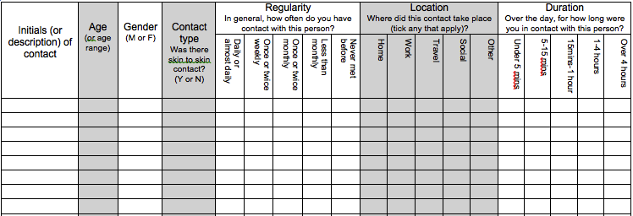
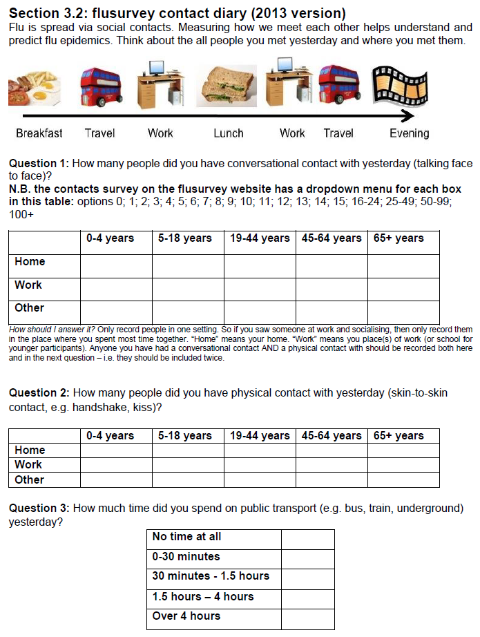
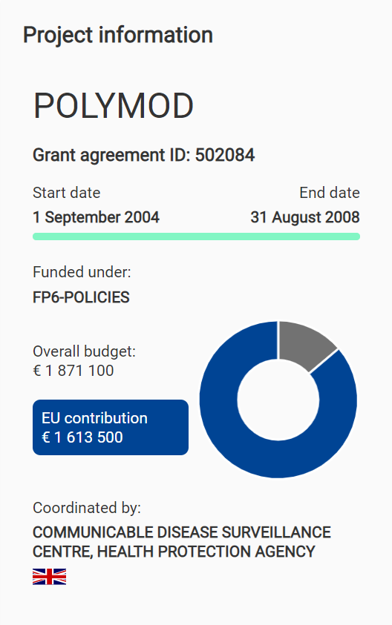
Contact survey
Project information
POLYMOD
Grant agreement ID : 502084
Start date
End date
1 September 2004
31 August
Funded under : FP6-POLICIES
Coordinated by : COMMUNICABLE DISEASE SURVEILLANCE CENTER, HEALTH PROTECTION AGENCY
Overall budget : € 1 871 100
EU contribution € 1 613 500
UK flusurvey contact diary
[Eames et al. PLoS Comp Bio 2012]
POLYMOD contact diary [Mossong et al. PLoS Med 2008]
Notes:
UK flusurvey 2012년 영국 3338명 Online
POLYMOD 2008년 유럽8개국 7290명 Paper

Slide 24
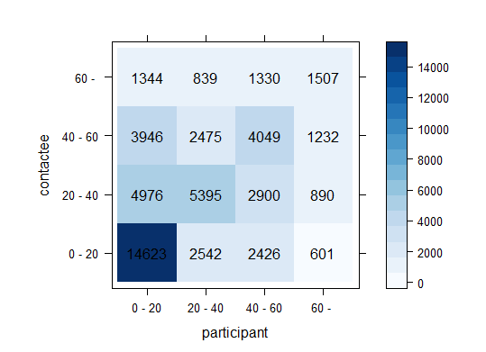
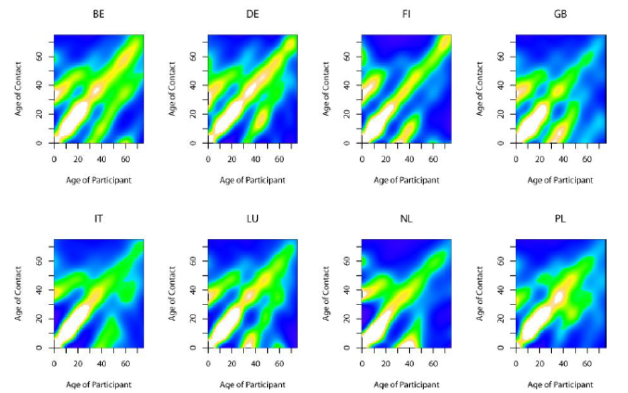
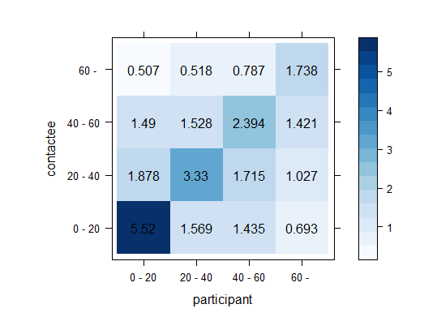
Contact matrix
Smoothed contact matrices for each country based on physical contacts weighted by sampling weights [Mossong et al. PLoS Med 2008]

Slide 25
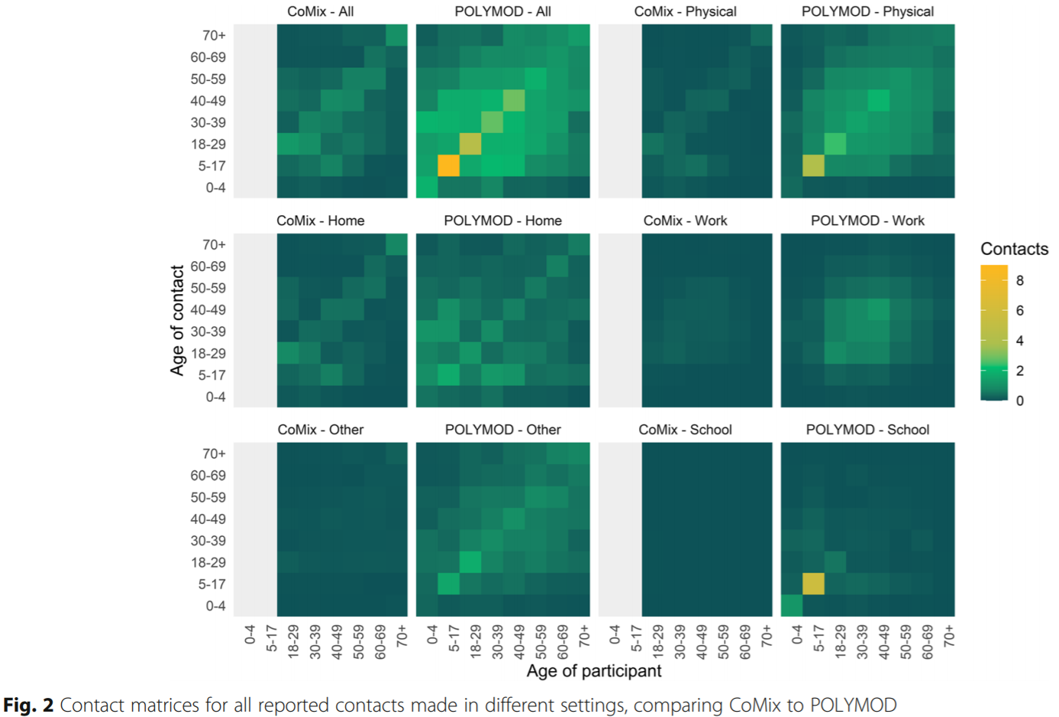
Quantifying the lockdown in the UK
Contact matrices for all reported contacts made in different settings, comparing CoMix to POLYMOD [Jarvis et al. BMC medicine 2020]
Notes:
The mean number of contacts per person measured during this study was 2.8 which was 74% lower than was measured in POLYMOD (10.8)

Slide 26
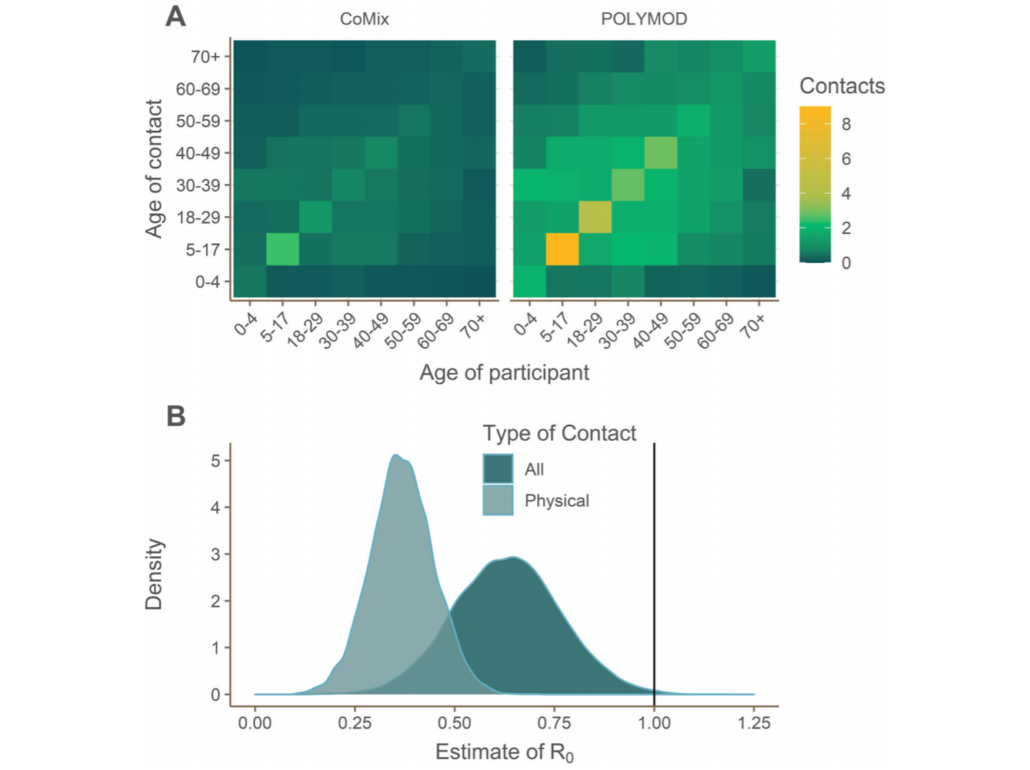
Reduction in transmission and R₀
Estimated reduction in reproduction number due to physical distancing for all and physical contacts separately [Jarvis et al. BMC medicine 2020]

Slide 27
References
Eames, Ken TD, et al. "Measured dynamic social contact patterns explain the spread of H1N1v influenza." PLoS Comput Biol 8.3 (2012): e1002425.
Farrington, C. Paddy. "Modelling forces of infection for measles, mumps and rubella." Statistics in medicine 9.8 (1990): 953-967.
Jarvis, C. I., et al. "Quantifying the impact of physical distance measures on the transmission of COVID-19 in the UK. medRxiv." DOI 10.2020.03 (2020): 31-20049023.
Mossong, Joël, et al. "Social contacts and mixing patterns relevant to the spread of infectious diseases." PLoS Med 5.3 (2008): e74.v

Slide 28
Supplement Information

Slide 29
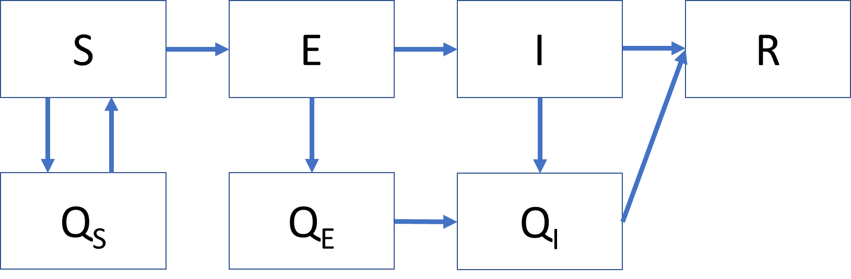
Impact of COVID-19 controls in Korea

Slide 30
Impact of COVID-19 controls in Korea
Model calibration to cumulative cases
Impact of social distancing on the COVID-19
Estimated net reproduction number
Effect of the coverage rates on the COVID-19

Slide 31

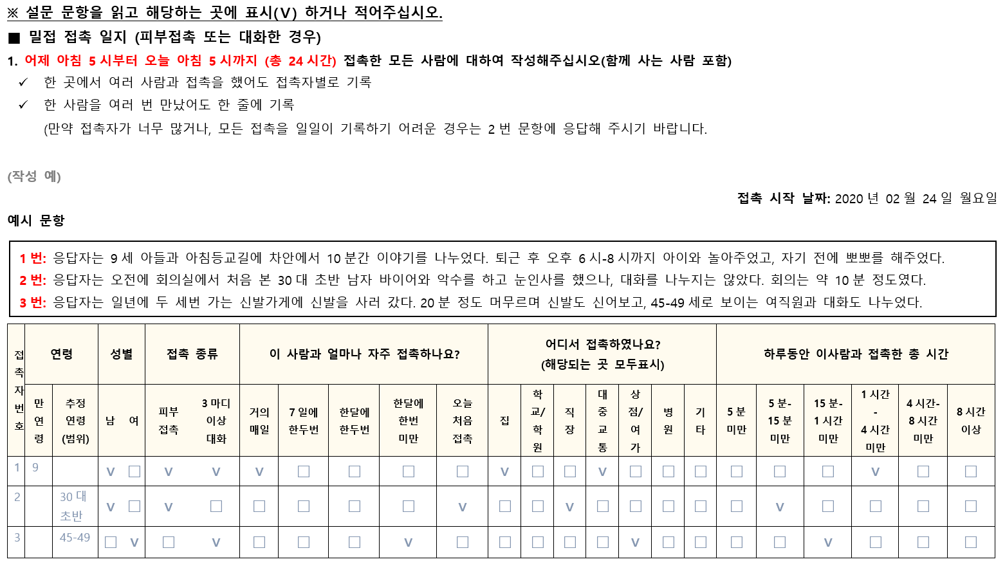
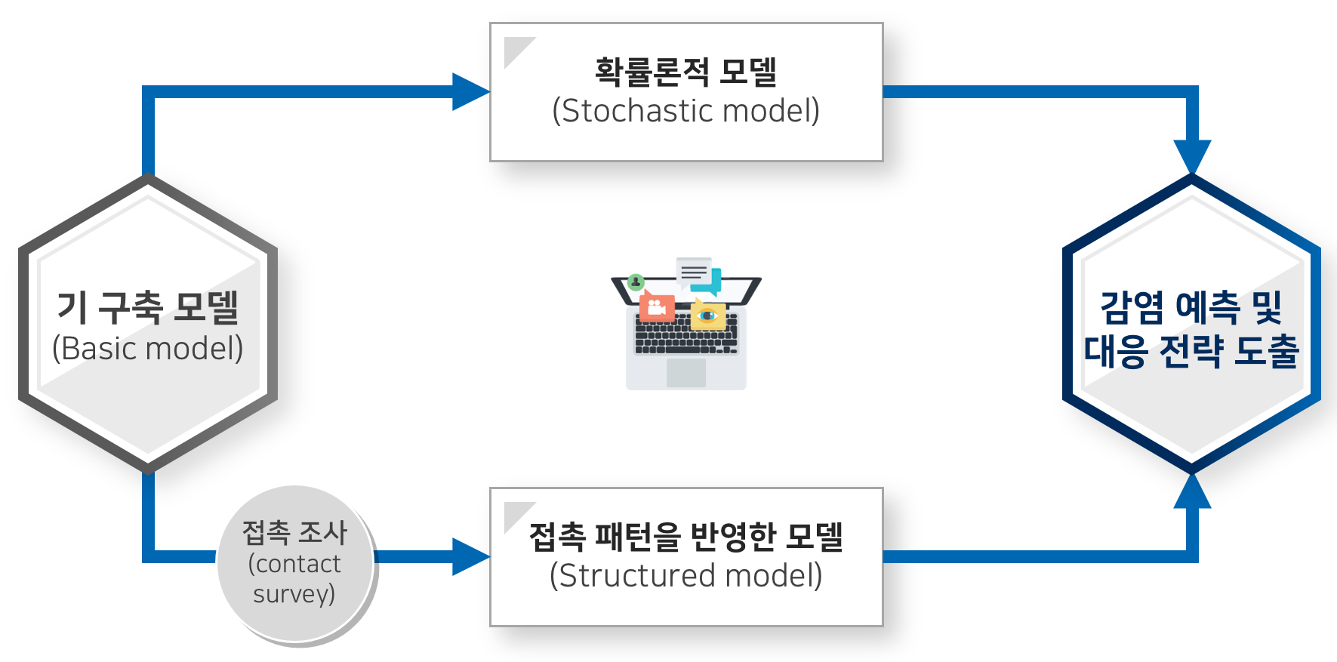
Contact matrix in Korea?

